Slide 1
Futuristic Body Pose Language Detection System Using Convolution Neural Network
Paper ID : ONA51
Author 1- Dr.C.Amuthadevi
Autho 2- Sarthak Mittal
Author 3- Dhruva Bhatacharya

Slide 2
ABSTRACT
The human body serves as a powerful communication channel, and accurately detecting its poses underpins the next generation of human-computer interaction (HCI). This paper delves into a cutting-edge approach for body pose detection, leveraging the transformative power of next-generation Convolutional Neural Networks (CNNs).
We transcend current limitations by meticulously constructing a futuristic dataset. This encompasses diverse body types, clothing styles, and environmental conditions anticipated in future scenarios, such as advanced robotics environments, immersive virtual worlds, and dynamic lighting conditions. To enhance model generalizability, we explore advanced data augmentation techniques, including simulated occlusions by objects not present in the training data and realistic variations in lighting and shadows.
The CNN architecture is meticulously crafted, potentially incorporating groundbreaking advancements in 3D pose estimation. We leverage cutting-edge hardware platforms optimized for real-time processing, enabling seamless integration into future HCI applications. This includes exploring lightweight CNN architectures designed specifically for resource-constrained edge devices, paving the way for ubiquitous body pose detection.
While achieving high accuracy remains paramount, a robust system demands more. Advanced optimization techniques will not only enhance accuracy but also improve the model's ability to handle unforeseen poses and challenging scenarios. To foster trust and transparency in this evolving technology, explainable AI methods will be integrated. This will allow us to understand the model's decision-making process, providing valuable insights into its pose estimations.

Slide 3
INTRODUCTION
Decades of research have focused on deciphering human emotions through facial expressions, but what if the key lies not just in our faces, but in the symphony of our bodies? Enter the Futuristic Body Pose Language Detection System, a revolutionary project harnessing the power of Convolutional Neural Networks (CNNs) to unlock the silent language of movement.
This groundbreaking system transcends the limitations of traditional emotion recognition by incorporating body posture, gestures, and subtle movements into its analysis. Imagine it reading the intricate choreography of a raised shoulder, a clenched fist, or a hesitant step, weaving them into a tapestry of understanding far richer than facial expressions alone. This holistic approach promises to unlock a nuanced and accurate portrayal of human emotions,
paving the way for a future of deeper human-machine interaction.
At the heart of this system lies the remarkable ability of CNNs, inspired by the human visual cortex, to extract meaningful features from images and videos. By analyzing intricate patterns and relationships within the data, the system learns to associate specific body language cues with distinct emotions. This intricate learning process, fueled by a vast dataset of labeled body images, allows the system to refine its understanding and achieve exceptional
accuracy in deciphering the unspoken language.
The potential applications of this futuristic project are vast and transformative. Imagine educational systems adapting teaching methods based on students' emotional states, healthcare professionals gaining deeper insights into their patients' nonverbal communication or customer service interactions revolutionized by machines recognizing and responding to emotional cues.

Slide 4
MOTIVATION
Existing methods often focus on specific tasks like pedestrian detection or limited pose estimation for specific body parts. The authors propose a more generic model applicable to a wider range of scenarios.
● Proposed Approach: The paper leverages the pictorial structures framework. This allows their model to handle a variety of human poses, from simple standing postures to complex athletic movements. It can also
handle upper-body detection and pose estimation.
● Key Contributions: This research demonstrates that a single model can effectively address both people detection and articulated pose estimation. It provides a framework that can handle a wider variety of human
poses and scenarios compared to previous methods.

Slide 5
REQUIREMENT GATHERING
INTEGRATION REQUIREMENTS:
Determine if the chatbot needs to integrate with other software or platforms. For example, it might need to access data from spreadsheets, databases, or cloud storage. Such as Python, mediapipe, Open CV and numpy.
DATA REQUIREMENTS:
It massive and diverse dataset, thousands or even millions of labeled images and videos. Each one should showcase various body language cues and their corresponding emotions. Imagine a library of confident poses, nervous fidgets, and joyful smiles, all captured and labeled for the system to learn from.High-resolution images and videos free from noise are crucial. This ensures the system learns from clear examples, not blurry distractions.
2-4 GB for a simple model.
4-8 GB for the Moderate model.
16 GB for High complexity models.
USER INTERFACE REQUIREMENTS:
It is also known as system's brain. Popular frameworks like TensorFlow or PyTorch provide the foundation for building and training the Convolutional Neural Network (CNN) that will become the core of the system.

Slide 6
LITERATURE SURVEY
S.no 1 | Author G. Anantha Rao; K. Syamala; P. V. V. Kishore; | Title Stabilizing motion tracking using retrieved motion priors | Journal Name,Year A. S. C. S. Sastryn (2022)
Methodology:This paper proposes a novel 3D Convolutional Neural Network (CNN) architecture for sign language recognition. It leverages multiple data sources:
Color video stream: Provides RGB information about hand shapes and body movements.
Depth video stream: Offers distance information for better understanding of hand and body positions.
Body skeleton data: Tracks key body joint locations, capturing motion trajectories.
The key innovation lies in using 3D convolution kernels applied to capture features across both spatial and temporal dimensions (multiple video frames). This allows the model to extract motion information crucial for sign language recognition.
Advantages:
Improved accuracy: Utilizing multiple data sources and capturing motion information leads to better recognition of sign language gestures compared to traditional feature-based methods.
Robustness: Subsampling layers improve resilience to slight variations in hand and body movements, making the model more practical for real-world use.
Automatic feature extraction: CNNs learn features directly from the raw data, eliminating the need for manual feature engineering, which can be tedious and prone to bias.
Disadvantages:
Computational cost: Training 3D CNNs can be computationally expensive and time-consuming due to the large amount of data and complex calculations involved.
Data dependence: The model's performance relies heavily on the quality and size of the training data. Insufficient or biased data can lead to inaccurate recognition.
Limited vocabulary: This specific model is trained on 25 sign words, while sign languages consist of hundreds or even thousands of signs. Expanding the vocabulary requires significantly more data and training time.

Slide 7
S.no 2 | Author Muneer Al-Hammadi; Ghulam Muhammad; Wadood Abdul; Mansour Alsulaiman; Mohamed A. Bencherif; Mohamed Amin | Title Hand Gesture Recognition for Sign Language Using 3DCNN | Journal,Year IEEE 27 April 2020
Methodology:The paper propose an automated framework for body language based emotion recognition starting from regular RGB videos.
Normalization: The study proposes a method to normalize the spatial dimensions of gesture videos based on facial position, facial length, and body part ratios. This allows for flexible hand placement within the frame and eliminates the need for a fixed distance from the camera.
3DCNN Model: A 3D convolutional neural network (CNN) model is used to learn region-based spatiotemporal features for gesture recognition. The model takes a sequence of RGB frames as input and does not require additional channels, colored gloves, or complex setups.
Advantages:
Efficient: The proposed approach utilizes transfer learning to address the limitation of small labeled datasets commonly found in hand gesture recognition.
Robust: The normalization method allows for flexibility in hand placement and camera distance, making the system robust to variations in setup.
Spatiotemporal Features: The 3DCNN model effectively captures both spatial and temporal information within gestures, leading to improved accuracy.
Disadvantages:
Computational Cost: 3DCNN models can be computationally expensive, especially for long video sequences.
Limited Dataset Dependence: The performance of transfer learning is dependent on the quality and relevance of the pre-trained model to the specific hand gesture dataset.

Slide 8
S.no 3 | Author Kshitij Bantupalli; Ying Xie | Title American Sign Language Recognition using Deep Learning and Computer Vision | Journal,Year IEEE 24 January 2020
Methodology:
Dataset: The study uses a custom American Sign Language dataset of 100 gestures performed multiple times by a single signer under various lighting and speed conditions. Each video is broken down into 300-frame sequences and augmented to increase data volume.
Inception CNN: The proposed system utilizes the Inception convolutional neural network (CNN) for spatial feature extraction from video frames. This model has been pre-trained on a large image dataset and is fine-tuned for sign language recognition.
LSTM RNN: Two approaches are used for extracting temporal features using Long Short-Term Memory (LSTM) recurrent neural networks (RNNs):
Advantages:
Transfer Learning: Utilizing the pre-trained Inception CNN reduces training time and data requirements compared to training from scratch.
Spatiotemporal Feature Extraction: The combination of CNN for spatial features and LSTM for temporal features allows for comprehensive gesture representation.
Two LSTM Approaches: Exploring different LSTM input sources (Softmax vs. Global Pool) provides insights into optimal feature utilization for gesture classification.
Disadvantages:
Limited Dataset Size: The study uses a relatively small dataset compared to other sign language recognition research. This might limit the generalizability of the model to diverse signers and environments.
Single Signer Dependence: The system may struggle to recognize gestures from different signers due to variations in hand shapes and signing styles.
Computational Cost: Training and running deep neural networks like Inception and LSTM can be computationally expensive, requiring significant hardware resources.
.

Slide 9
S.no 4 | Author Fatemeh Noroozi; Ciprian Adrian Corneanu; Dorota Kamińska; Tomasz Sapiński; Sergio Escalera | Title Survey on Emotional Body Gesture Recognition | Journal,Year IEEE 16 October 2019
Methodology:
Human Body Modeling: Two main approaches are discussed for modeling the human body:
Part-based models: Represent the body as a collection of independently detected parts (head, hands, torso) with potential refinement using domain knowledge.
Kinematic models: Represent the body as a series of interconnected joints with defined degrees of freedom, often mimicking the human skeleton.
Emotion Models: Discusses various models of emotion used in affective computing, but without specifying the exact model chosen for the body gesture recognition system.
Automatic Recognition Pipeline: Briefly outlines the standard pipeline for recognizing emotions from body gestures.
Advantages:
Comprehensive overview: Provides a broad introduction to the field of automatic emotion recognition from body gestures.
Comparative analysis: Discusses different human body and emotion models, allowing for informed decision-making in system design.
Disadvantages:
Lack of specifics: Doesn't delve into the details of the proposed system, particularly the chosen emotion model and classification algorithm.
Limited scope: Excludes discussion of facial expressions and speech, which can provide complementary information for emotion recognition.
Limited evaluation: Doesn't mention any specific benchmark datasets or evaluation metrics for the system, making it difficult to assess its performance.

Slide 10
S.no 5 | Author G. Anantha Rao; K. Syamala; P. V. V. Kishore; A. S. C. S. Sastryn | Title Deep convolutional neural networks for sign language recognition | Journal,Year IEEE 18 March 2019
Methodology:
Dataset: The authors created a custom dataset of 200 Indian Sign Language (ISL) words performed by 5 signers in 5 viewing angles (representing different phone holding positions). Each recording is 2 seconds (60 frames) long.
CNN Architecture: The proposed system uses a multi-stage CNN with four convolutional layers, stochastic pooling, dense layers, and SoftMax output. Key elements:
Training and Testing:
Three batches used for training: Batch-I (1 signer), Batch-II (2 signers), Batch-III (3 signers).
Testing on two discrete video sets with different signers and viewing angles.
Advantages:
Novelty: Explores deep CNNs for selfie sign language recognition, a relatively unexplored area.
Custom Dataset: Creation of a unique dataset for ISL in selfie mode contributes to the field.
Improved Recognition Rates: Achieves higher accuracy compared to traditional methods.
Disadvantages:
Limited Dataset Size: 200 words may not be sufficient for generalization and real-world scenarios.
Single Platform Training: Testing only on HPC platform limits generalizability to mobile devices.

Slide 11
S.no 6 | Author Jamie Shotton; Andrew Fitzgibbon; Mat Cook; Toby Sharp; Mark Finocchio; Richard Moore; Alex Kipman; Andrew Blake | Title Real-time human pose recognition in parts from single depth images | Journal,Year IEEE 22 August 2019
Methodology:
Object recognition approach: Instead of directly estimating the 3D pose of the body, the method first predicts the body part labels for each pixel in the depth image. This simplifies the problem from estimating complex skeletal structure to classifying individual body parts.
Large synthetic training dataset: A large and diverse dataset of synthetic depth images and corresponding body part labels is generated using computer graphics. This allows the classifier to learn robust features that are invariant to pose, body shape, clothing, and other variations.
Per-pixel body part distribution: A random forest classifier is trained to predict the body part label for each pixel in the depth image. This results in a probability distribution over body parts for each pixel.
Advantages:
Real-time performance: The method can run in real-time on commodity hardware, making it suitable for applications like human-computer interaction and augmented reality.
Accuracy: The method achieves state-of-the-art accuracy on both synthetic and real depth images, even for challenging poses and multiple people.
Robustness: The use of a large synthetic training dataset and per-pixel body part predictions makes the method robust to variations in pose, body shape, clothing, and occlusions.
No temporal information required: The method does not require information from previous frames, making it suitable for applications where there is no temporal continuity.
Disadvantages:
Accuracy limitations: While the method is accurate, it can still make mistakes, especially for challenging poses or occlusions.
Sensitivity to depth noise: The accuracy of the method can be affected by noise in the depth image.
Large training dataset required: Training the random forest classifier requires a large amount of data, which can be time-consuming and expensive to generate.

Slide 12
S.no 7 | Author Simon Hadfield; Richard Bowden | Title Kinecting the dots: Particle based scene flow from depth sensors | Journal,Year IEEE 26 January 2012
Methodology:
Particle Representation: Scene points are represented as particles with associated 3D velocity distributions. This allows for maintaining multiple motion hypotheses for each point, avoiding the over-smoothing issues of traditional methods.
Ray Resampling: Each epipolar ray (corresponding lines in consecutive frames) is treated as a separate particle filter. This ensures sufficient coverage of the scene even with sparse initial estimates.
Depth Sensor Integration: Depth data from sensors like the Kinect provides accurate scene structure, simplifying motion estimation compared to traditional multi-viewpoint camera rigs.
Cost Function: Particle weights are updated based on a photometric cost (matching image intensities between frames) and a smoothness cost (encouraging neighboring points to have similar motion).
Advantages:
Accuracy: Kinecting the dots achieves comparable accuracy to existing multi-viewpoint approaches while working with just a single image sequence and depth data.
Computational Efficiency: It runs significantly faster than multi-viewpoint methods, making it suitable for real-time applications.
No Over-smoothing: The particle filter representation avoids the common problem of over-smoothing at object boundaries, preserving sharp motion discontinuities.
Single Camera Compatibility: It works with readily available depth sensors like the Kinect, eliminating the need for expensive setups.
Disadvantages:
High Memory Requirements: Maintaining multiple particle hypotheses for each point can be memory-intensive for complex scenes.
Sensitivity to Noise: Depth sensor noise can affect the accuracy of the motion estimation.
Limited Scale: Although accurate for smaller scenes, the performance might degrade for large-scale environments.

Slide 13
S.no 8 | Author Pedram Azad; Tamim Asfour; Rudiger Dillmann | Title Robust real-time stereo-based markerless human motion capture | Journal,Year IEEE 15 February 2020
Methodology:
Calibration: Stereo cameras are calibrated to estimate depth information from disparity maps.
Background Subtraction: Background pixels are separated from foreground, focusing on the human subject.
Body Region Detection: Key body parts like head, hands, and torso are identified using image processing techniques.
3D Pose Estimation: A particle filter framework tracks the identified body parts in 3D space. Each particle represents a possible pose, and its weight is updated based on how well it aligns with the observed disparity and image cues.
Motion Model: A dynamic motion model, often learned from training data, helps predict the body's movement between frames, guiding the particle filter.
Advantages:
Real-time performance: Enables immediate and interactive applications like virtual reality and human-computer interaction.
Markerless: Eliminates the need for cumbersome and restrictive markers, offering more natural and comfortable capture.
Stereo depth maps: Provides richer 3D information compared to single depth sensors, enhancing accuracy and robustness.
Disadvantages:
Computational complexity: Real-time processing of stereo data and particle filtering can be demanding.
Sensitivity to calibration: Improper camera calibration can significantly affect depth estimates and pose accuracy.
Limited accuracy: Compared to high-end marker-based systems, absolute accuracy might be lower, especially for fine details.
Occlusion limitations: While the system handles partial occlusions, complete body part blockage can disrupt tracking.

Slide 14
S.no 9 | Author G. Anantha Rao; K. Syamala; P. V. V. Kishore; A. S. C. S. Sastryn | Title Stabilizing motion tracking using retrieved motion priors | Journal,Year IEEE 29 July 2022
Methodology:
Retrieving Motion Priors:A database of motion patterns is created from various videos or motion capture data.When tracking a new motion sequence, relevant priors are retrieved based on similarities in appearance or motion features.
Incorporating Priors into Tracking:The retrieved priors serve as constraints or guidance during the tracking process.
Advantages:
Improved Stability: Priors can help maintain tracking accuracy even with occlusions, noise, or abrupt movements.
Enhanced Physical Plausibility: Priors encourage physically realistic motion, reducing artifacts and inconsistencies.
Reduced Ambiguity: Priors can help resolve ambiguities in challenging tracking scenarios.
Generalization to Unseen Motions: Priors can guide tracking of motions not previously encountered.
Disadvantages:
Computational Cost: Retrieving and incorporating priors can add computational overhead.
Prior Quality: The performance heavily depends on the quality and relevance of the motion database.
Limited Generalizability: Priors might not always generalize well to new scenarios or domains.
Domain Specificity: Priors might need to be tailored for specific applications (e.g., human motion, vehicle tracking).

Slide 15
S.no 10 | Author Amit Bleiweiss, Eran Eilat Gershom Kutliroff | Title Markerless motion capture using a single depth sensor | Journal,Year ACM digital Library 20 December 2020
Methodology:
Preprocessing: Noise reduction and background segmentation are applied to the depth image.
Body Region Detection: A Hough Forest, a robust machine learning algorithm, identifies potential body regions based on shape and size features in the depth data.
Particle Filter Initialization: Particles are placed within the detected body regions, each representing a possible 3D pose of the body.
Particle Propagation: Particles are propagated forward in time based on a motion model, typically assuming smoothness of movement.
Weight Update: Each particle's weight is updated based on how well it aligns with the next depth image. This involves projecting the estimated body pose onto the next frame and comparing the projected depth with the actual measurements.
Resampling and Iteration: Particles with higher weights are duplicated, while those with lower weights are discarded. The process then iterates through several frames, refining the pose estimation for each particle.
Pose Estimation: The final pose is typically determined by the particle with the highest weight, representing the most likely 3D configuration of the body.
Advantages:
Cost-effective: Requires only a single depth sensor, significantly cheaper than traditional marker-based systems.
Portable and Convenient: No need for cumbersome markers or specialized setups, allows for flexible recording environments.
Disadvantages:
Limited Accuracy: Compared to marker-based systems, accuracy can be lower, especially for challenging poses or rapid movements.
Sensitivity to Depth Noise: Noise in the depth data can significantly affect pose estimation.
Computational Intensity: Processing large amounts of depth data can be computationally demanding.

Slide 16
S.no 11 | Author Alexandru O. Balan; Leonid Sigal; Michael J. Black; James E. Davis; Horst W. Haussecker | Title Detailed Human Shape and Pose from Images | Journal,Year IEEE 16 July 2021
Methodologies:
3D Parametric Models: This approach fits a pre-defined 3D body model with adjustable parameters (like joint angles, body proportions) to the image data. Advantages include efficiency and robustness to partial occlusions. Disadvantages include limitations in capturing fine details and potentially unrealistic body representations.
Deep Learning-based methods: Convolutional neural networks (CNNs) are trained on large datasets of images paired with 3D body information. These models directly predict 3D shape and pose parameters or estimate heatmaps of body parts. Advantages include flexibility in capturing complex shapes and pose variations. Disadvantages can include high computational demands, dependence on training data quality, and potential black-box nature.
Model-Free Methods: Techniques like silhouette-based analysis, statistical models of human shape variations, and image segmentation are used to infer 3D information without relying on pre-defined models. Advantages include flexibility and handling diverse body types. Disadvantages can be limitations in accuracy and detail, especially for challenging poses or occlusions.
Advantages:
Enhanced understanding of human movement and behavior: Useful in fields like sports analysis, medical diagnosis, and human-computer interaction.
Realistic character animation and virtual reality applications: Enables creation of lifelike avatars and immersive experiences.
Augmenting perception in robotics and autonomous systems: Robots can better understand human actions and interact more safely in shared environments.
Disadvantages:
Accuracy limitations: Current methods, especially 2D-based approaches, may not always provide highly accurate and detailed reconstructions, especially for challenging poses or body types.
Computational requirements: Deep learning-based methods can be computationally demanding, limiting real-time applications.
Privacy concerns: Applications involving human body shape reconstruction raise privacy concerns regarding data collection and usage.

Slide 17
S.no 12 | Author Jonathan Deutscher ,Ian Reid | Title Articulated Body Motion Capture by Stochastic Search | Journal,Year SPRINGER 20 February 2019
Methodology:
Model Definition: A 3D skeleton model is created representing the body's joints and their connections.
Image/Video Input: Visual data of the moving body is captured, often using multiple cameras for 3D reconstruction.
Initialization: The model is positioned roughly in the first frame, aligning virtual joints with estimated body positions.
Stochastic Search:
Candidate poses are generated by randomly adjusting model joint angles within defined constraints.
Each pose is evaluated using a cost function that measures its agreement with visual data and adherence to biomechanical constraints.
Poses with lower costs (better matches) are retained and used to guide further search.
Advantages:
Flexibility: Can handle various body shapes, motions, and camera setups.
Robustness to noise and occlusions: Stochastic search can explore multiple solutions, mitigating issues like missing data points.
Disadvantages:
Computational cost: Stochastic search can be computationally demanding, especially for high-resolution models and large datasets.
Local minima: The optimization process might get stuck in suboptimal solutions, requiring careful parameter tuning and search strategies.
Sensitivity to initialization: Accurate initial model placement is crucial for successful convergence.

Slide 18
S.no 13 | Author J. Deutscher; B. North; B. Bascle; A. Blake | Title Tracking through singularities and discontinuities by random sampling | Journal,Year IEEE 6 AUGUST 2018
Methodology:
Initialization:Define a model for the object or system to be tracked, including its state variables and motion constraints.Provide an initial estimate of the object's state.
Prediction:Propagate the state estimate forward in time using a dynamic model, accounting for potential discontinuities or singularities.
Random Sampling:Generate a large number of particles (hypothetical state estimates) around the predicted state.These particles explore a wider range of possibilities, including those that might deviate from traditional filtering techniques.
Evaluation:Assign weights to each particle based on how well they match the observed data (e.g., sensor measurements).Particles that better align with the observations receive higher weights.
Resampling:Discard particles with low weights and duplicate those with high weights to focus the search on more promising regions.
Update:Compute a weighted average of the resampled particles to obtain a new, refined state estimate.
Iteration:Repeat steps 2-6 as new observations become available, continuously tracking the object's state.
Advantages:
Robustness to Singularities and Discontinuities: Effectively handles situations where traditional filtering methods (e.g., Kalman filters) can break down due to abrupt changes or non-Gaussian distributions.
Non-Linear and Non-Gaussian Models: Accommodates more complex and realistic models, not limited by assumptions of linearity or Gaussian noise.
Disadvantages:
Computational Cost: Generating and evaluating a large number of particles can be computationally expensive, especially for high-dimensional systems.
Parameter Tuning: Requires careful tuning of parameters such as the number of particles and resampling thresholds for optimal performance.

Slide 19
S.no 14 | Author J.M. Coughlan; A.L. Yuille | Title Manhattan World: compass direction from a single image by Bayesian inference | Journal,Year IEEE 15 March 2019
Methodology:
Assumptions: The algorithm relies on two key assumptions:
Manhattan World: The scene is constructed on a 3D grid, where walls and other structures align with cardinal directions (north, south, east, west).
Perspective Camera: The image is captured by a perspective camera with known focal length.
Edge Analysis: Edges are extracted from the image and segmented into horizontal and vertical lines.
Vanishing Point Estimation: Vanishing points (where parallel lines converge) are estimated for both horizontal and vertical edge segments.
Probability Model: A probabilistic model is defined based on the expected distribution of vanishing points in a Manhattan World scene. This model considers the camera orientation and perspective distortions.
Advantages:
Single Image Based: Requires only a single image, eliminating the need for calibration or additional sensors.
Robust to Noise: Performs well even with noisy images and partial occlusions.
Real-time Potential: The algorithm can be implemented efficiently for real-time applications.
Disadvantages:
Assumption Dependence: Relies on the validity of the Manhattan World and perspective camera assumptions, which might not hold true in all scenarios.
Accuracy Limitations: Compass direction estimates can be less accurate for complex scenes with cluttered backgrounds or deviations from the Manhattan World structure.
Limited Information: Only extracts compass direction, while other scene properties like 3D structure remain unavailable.

Slide 20
CHALLENGES AND LIMITATIONS IN EXISTING SYSTEM
Body Pose Language Detection System Using CNN Is essential for creating personalized and engaging chatbot experiences. However, there are some challenges and considerations that need to be addressed when dealing with working and usage of datasets . These include:
Limited Diverse Datasets: While amassing a large dataset is crucial, the current research might be limited by the availability of truly diverse datasets encompassing a wide range of ethnicities, ages, genders, body types, and cultural backgrounds. This can lead to bias in the model's interpretations.
Data Labeling Challenges: Developing consistent and clear labeling schemes for body language cues across diverse cultures remains an ongoing challenge. This can hinder the model's ability to generalize effectively.
Privacy Concerns: Balancing the need for data with user privacy and ethical considerations remains a major research gap. Techniques for secure data collection, anonymization, and user consent need further exploration.
Model Development and Performance:
Accuracy and Generalizability: There's an ongoing pursuit for CNN architectures that achieve high accuracy in body language recognition across diverse populations and contexts. Research can explore novel architectures, training methodologies, and data augmentation techniques to improve generalization.
Explainability and Transparency: Understanding how the CNN model arrives at its conclusions regarding emotions is crucial for responsible use. Research can focus on developing methods for explainable AI to make the decision-making process more transparent.
Real-world Applications and Integration:
Real-time Processing: While not an essential requirement, enabling real-time body language analysis demands more efficient hardware and software solutions, especially for resource-constrained environments. Optimizing the model for real-time performance is an active research area.
Integration with Existing Technologies: Exploring seamless integration with technologies in relevant fields (education, healthcare, customer service) can unlock the system's full potential. This requires research into interoperability and data exchange standards.
Ethical Considerations and Societal Impact:
Mitigating Misuse and Bias: Research is needed to address potential misuse of the technology for profiling, manipulation, or discrimination. Development of ethical guidelines and regulations is crucial.
Job Displacement: The potential impact of the technology on professions relying on body language reading requires careful consideration. Research can explore retraining and upskilling programs to minimize job displacement.
Cultural Sensitivity: Body language interpretation varies significantly across cultures. Research can focus on developing culturally aware models that avoid misinterpretations in diverse contex

Slide 21
OBJECTIVE OF THE PROJECT
Enhance human-computer interaction (HCI): If computers could read body language, they might engage with people in a more tailored and responsive manner. For instance, a virtual assistant may offer more timely and useful advice based on the user's body language signals, or a computer system could modify the speed and complexity of a game depending on the player's body language.
Boost security and surveillance: In public places like train stations and airports, suspicious conduct may be identified with the use of a body pose language detecting system. For instance, the system may be able to identify anxiousness or worry, which may be a harbinger of impending danger.
Enhance healthcare: Patients' indications of pain or distress might be recognized by a body pose language detection system.

Slide 22
INNOVATION IDEA OF THE PROJECT
The key innovation of this project is to leverage a 3D Convolutional Neural Network (CNN) architecture to capture both spatial and temporal features of body language. This approach holds the potential to significantly improve the accuracy and robustness of body language detection systems compared to traditional methods that solely rely on 2D CNN's or handcrafted features.
A. Beyond Facial Expressions: This system transcends traditional emotion recognition by incorporating body posture, gestures, and subtle movements into its analysis. It delves deeper, extracting meaning from the full symphony of non-verbal cues, leading to a more nuanced and accurate understanding of emotions.
B. Harnessing the Power of CNNs: Utilizing Convolutional Neural Networks (CNNs) inspired by the human visual cortex, the system excels at pattern recognition within images and videos. This allows it to learn the intricate associations between specific body language cues and distinct emotions, achieving exceptional accuracy in decoding the unspoken language.
C. Vast Dataset and Continuous Learning: The system is trained on a massive dataset of labeled body images, allowing it to refine its understanding and adapt to diverse body language expressions. This continuous learning process ensures the system remains relevant and accurate as it encounters new information.
D. Holistic Approach to Human-Machine Interaction: By understanding body language, the system fosters a more natural and intuitive form of human-machine interaction. Imagine applications in education where the system tailors teaching methods based on students' emotional states, or in healthcare where it aids therapists by deciphering patients' non-verbal communication.

Slide 23
SCOPE AND APPLICATION OF THE PROJECT
The scope of the project includes:
Research and development of a novel 3D CNN architecture for body language detection: The architecture should effectively capture both spatial and temporal features, enabling more accurate and robust body language detection.
Evaluation of the model's performance on benchmark datasets: The model's performance should be evaluated on benchmark datasets to demonstrate its effectiveness.
Investigation of the model's generalization ability: The model's performance should be evaluated on different datasets and domains to demonstrate its generalizability.
Exploration and analysis of the model's interpretability: The model's decision-making process should be analyzed to improve its interpretability and explainability.
.

Slide 24
The application of the project is on a wide range of areas, including:
Human-computer interaction (HCI): The system can enhance human-computer interactions by enabling machines to better understand and respond to human emotions and intentions.
Social robotics: The system can contribute to the development of socially intelligent robots that can interact with humans in a natural and engaging way.
Healthcare: The system can be used to monitor patient behavior and identify potential health risks based on body language cues.
Security and surveillance: The system can be used to detect suspicious or threatening behavior in public spaces and enhance security measures.

Slide 25
ALGORITHM
Step 1: Load the 3D human pose estimation pre-trained CNN model
Step 2: Input Image Preprocessing and Resizing it to a fixed size and pixel values normalizing.
Step 3: Preprocessed image Feed to the CNN model to obtain the predicted 3D pose.
Step 4: Calculate the loss between the predicted pose and the ground truth pose.
Step 5: Backpropagate the loss through the network and update the weights using an optimizer such as stochastic gradient descent (SGD).
Step 6: Iterate through 2-5 steps for all the training image datasets to obtain a fixed number of epochs.
Step 7: Evaluate the trained CNN model's performance on a image validation set by calculating metrics such as accuracy, precision.
Step 8: CNN model's Fine-tuning Model by Hyperparameters Adjustment or Changing the network architecture if the performances are unsatisfied.
Step 9: Deploy the 3D human Pose Estimation Trained CNN model In Real-World Applications by Integrating it into a Software or Mobile Application System.
Step 10: Deployed Model's Performance Monitoring and Optimizing at each time.

Slide 26
ARCHITECTURE
1.Data Preparation: To initiate the training of a CNN model, the initial phase involves preparing the training data. This needs to gather an extensive collection of images and their corresponding 3D human poses, performing data preprocessing tasks such as resizing images and normalizing pixel values, and segregating the data into training, validation, and test sets.
2. Network Architecture: After preparing the training data, the subsequent step is to opt for a suitable network architecture for the CNN model. This includes making choices regarding the number and kind of layers, the filter sizes, and the activation functions to be employed.
3. Loss Function: To evaluate the dissimilarity between the predicted 3D pose and the actual pose, a loss function is utilized. The mean squared error (MSE) loss is often employed as a popular option for 3D human pose estimation. Nevertheless, alternative loss functions such as the mean absolute error (MAE) or smooth L1 loss can also be utilized for this purpose.
4. Training: After selecting the appropriate network architecture and preparing the data, the subsequent phase is to train the CNN model. This step encompasses the configuration of hyperparameters such as the learning rate, batch size, and number of epochs. During the training process, the network weights are fine-tuned to reduce the loss function.
5. Evaluation: After training, the CNN model is evaluated on the test set to measure its performance. This involves measuring metrics such as accuracy, precision, and recall.
6. Fine-tuning: If the performance of the CNN model is not satisfactory, it can be fine-tuned by adjusting the hyperparameters or changing the network architecture.
7. Deployment: After the CNN model is trained and assessed, it can be utilized for 3D human pose estimation in real-world scenarios. The model can be incorporated into software systems or mobile applications to estimate the 3D pose from input images or video .
The lowest level of our two-stage feature detection pipeline is based on a standard convnet architecture, an overview of which is shown in Figure 2. Convnets, like their fully-connected, deep neural network counterparts, perform end-to-end feature learning and are trained with the back-propagation algorithm. However, they differ in a number of respects, most notably local connectivity, weight sharing, and local pooling. The first two properties significantly reduce the number of free parameters, and reduce the need to learn repeated feature detectors at different locations of the input. The third property makes the learned representation invariant to small with Conv input’s translations.

Slide 27
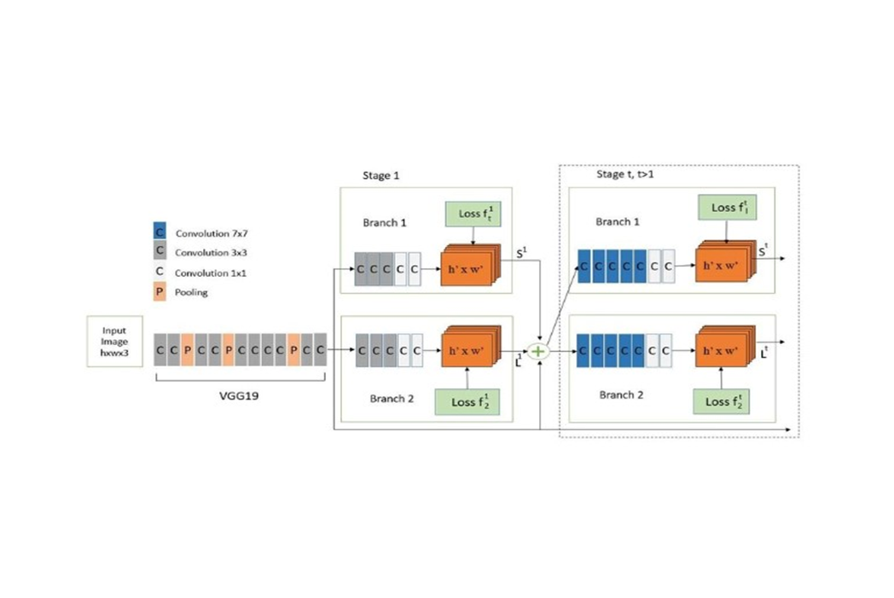
ARCHITECTURE

Slide 28
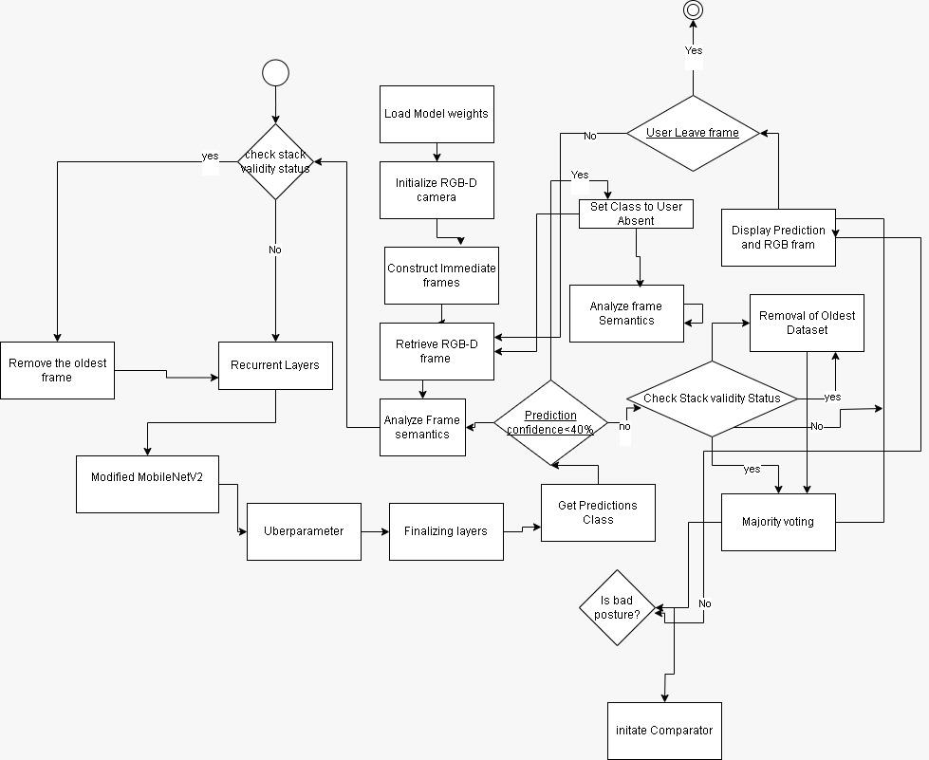
FlOW DIAGRAMS FOR THE PROPOSED MODULES

Slide 29
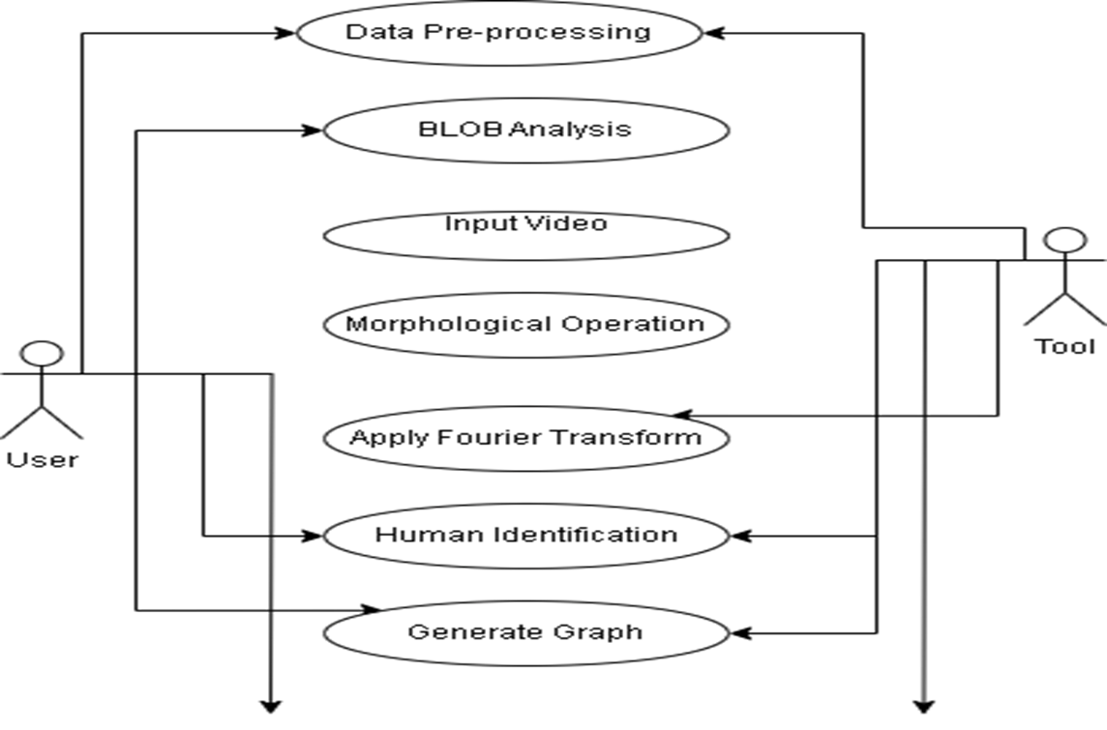
UML DIAGRAM FOR THE PROPOSED MODULES

Slide 30




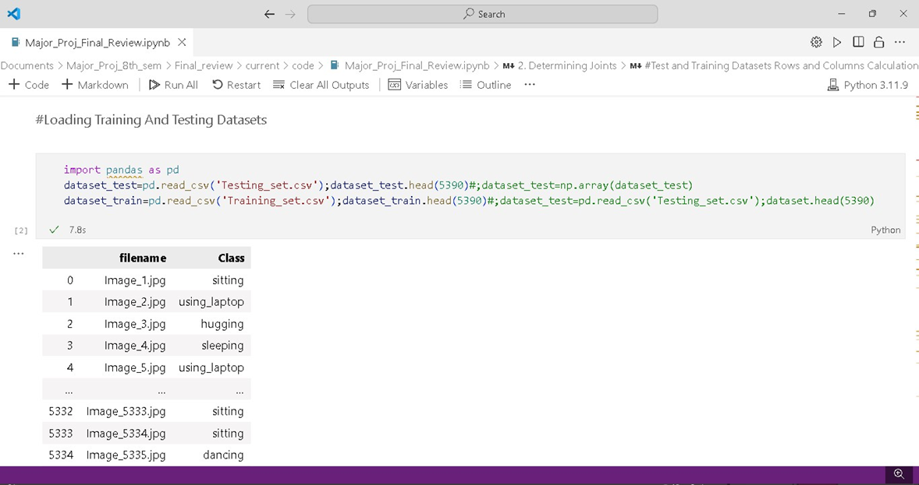
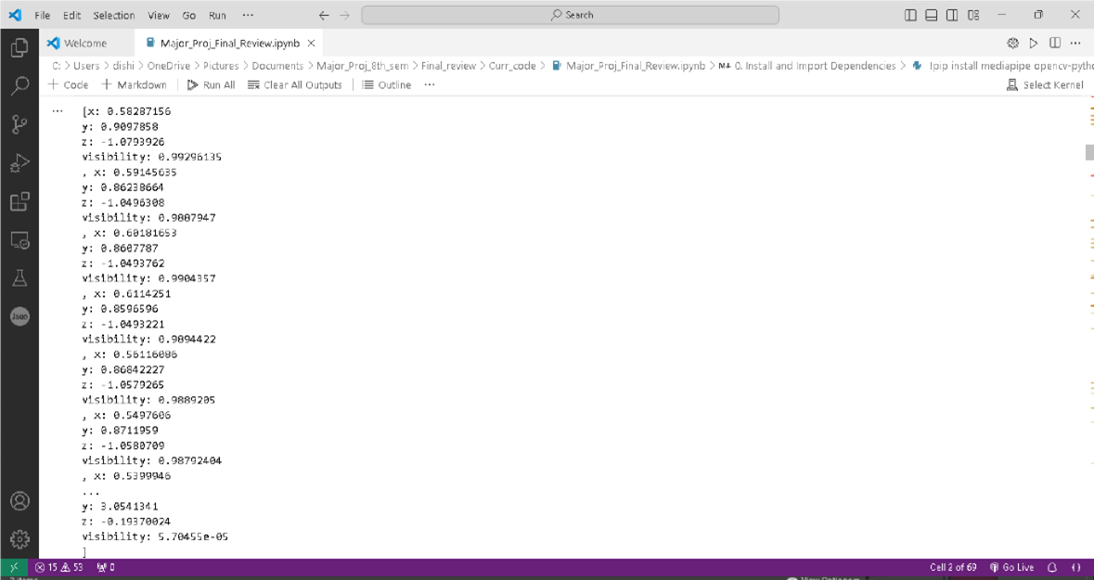
CODE IMPLEMENTATION

Slide 31

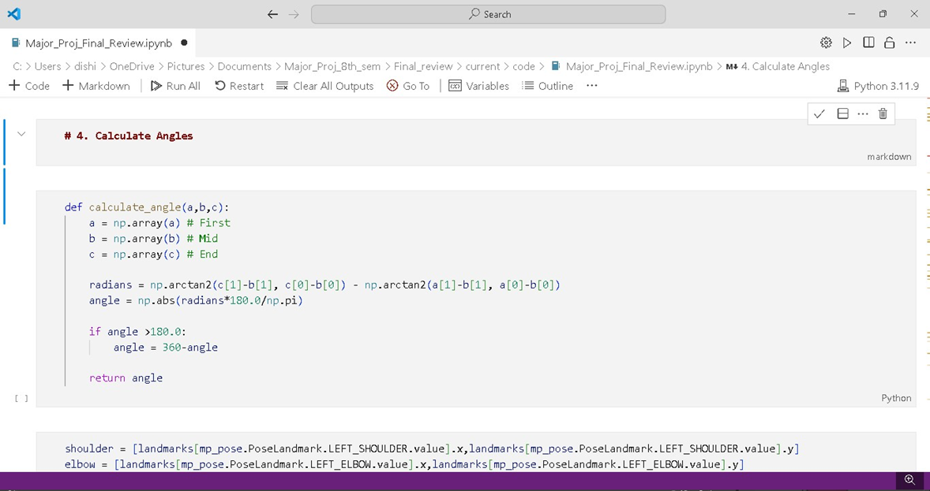
CODE IMPLEMENTATION

Slide 32
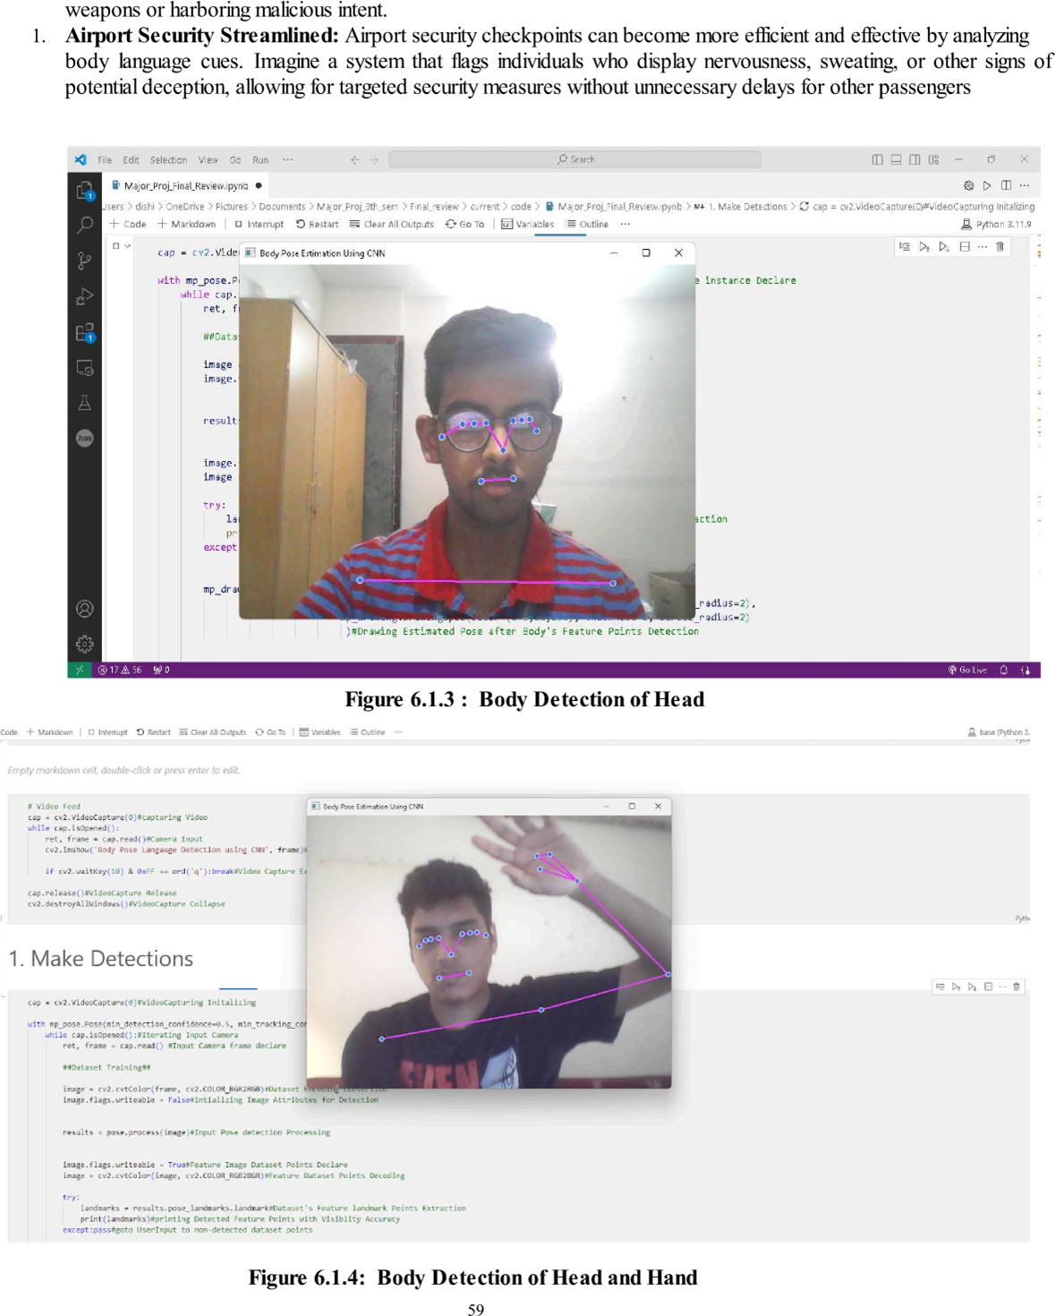
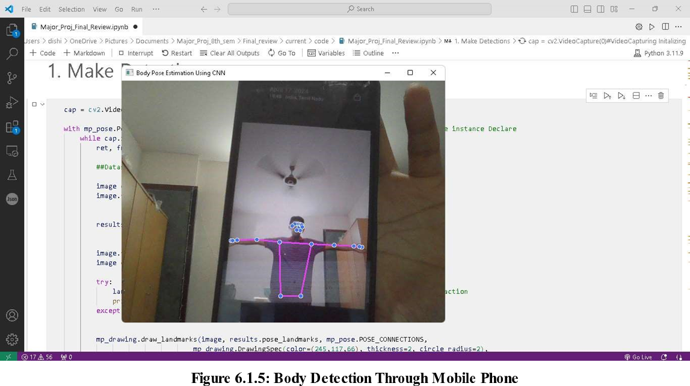
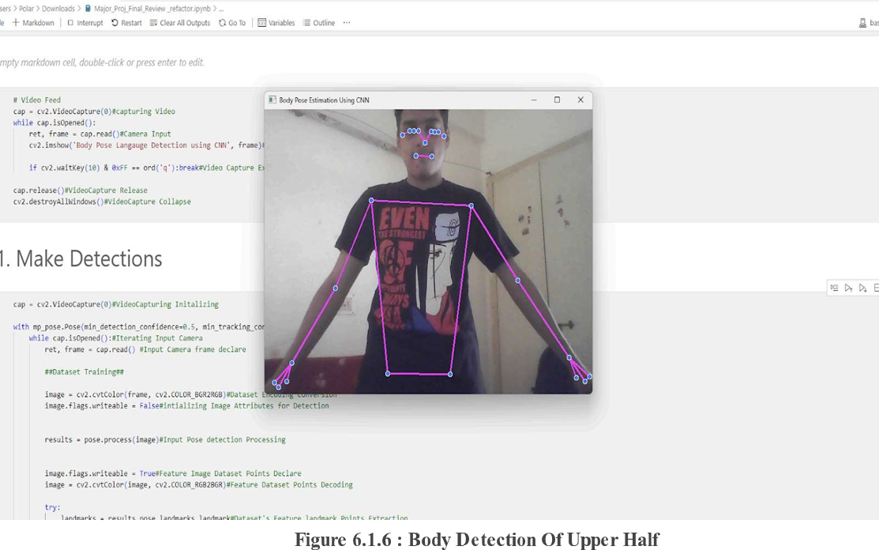
RESULT

Slide 33
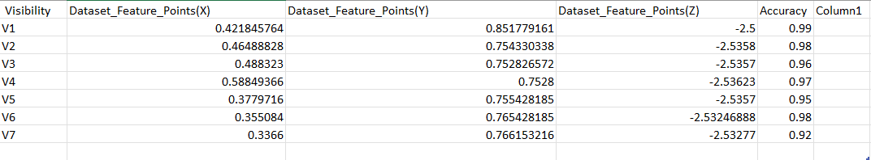
DATASET FEATURE POINT‘s ACCURACY TABULAR
PLOT

Slide 34
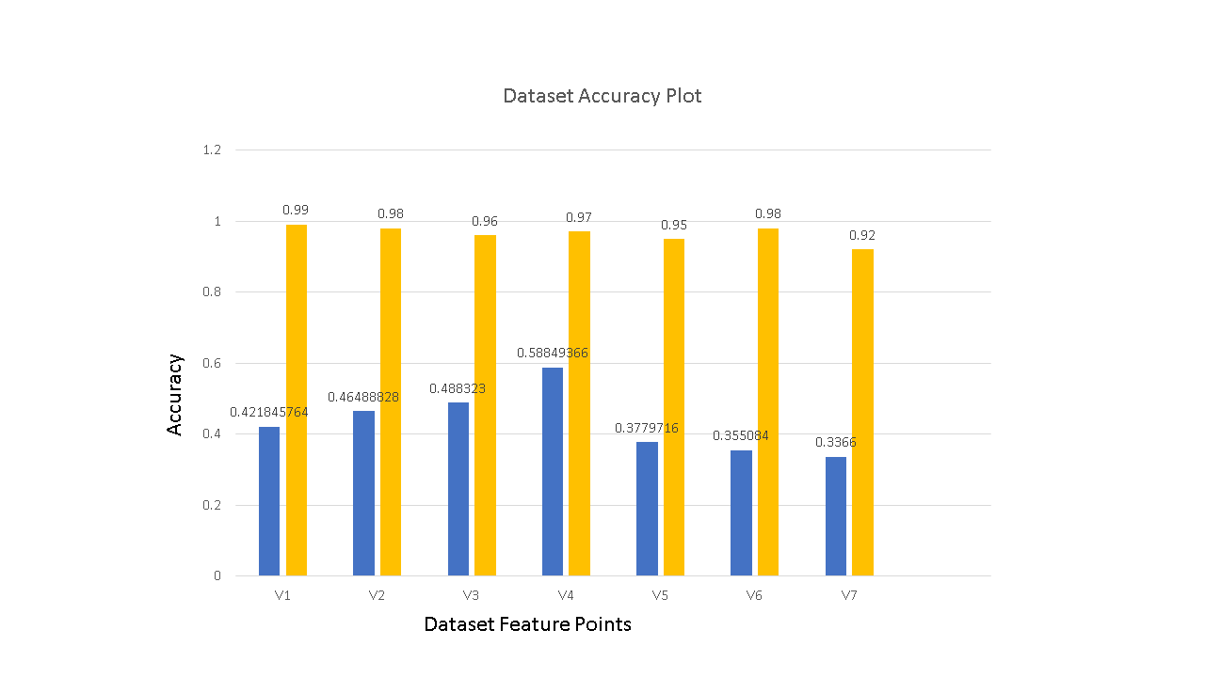
DATASET FEATURE POINT‘s ACCURACY GRAPH
PLOT

Slide 35
REFERENCES
[1] G. Anantha Rao; K. Syamala; P. V. V. Kishore; A. S. C. S. Sastryn, ‘Stabilizing motion tracking using retrieved motion priors’
,In Proceedings of the IEEE 7th International Conference on Computer and Communication Engineering Technology,2022.
[2] Alexandru O. Balan; Leonid Sigal; Michael J. Black; James E. Davis; Horst W. Haussecker, ‘Detailed Human Shape and Pose from Images’, IEEE explore,2021.
[3] Nourah Alswaidan and Mohamed El Bachir Menai, ‘A survey of state-of-the-art approaches for emotion recognition in text’, Springer,2020.
[4] Simon Hadfield and Richard Bowden, ‘Kinecting the dots: Particle based scene flow from depth sensors’, IEEE explore,2020
[5] Amit Bleiweiss, Eran Eilat Gershom Kutliroff, ‘Markerless motion capture using a single depth sensor’, ACM,2020.
[6] Mehmet Berkehan Akçay and Kemal Oğuz, ‘Speech emotion recognition:Emotional models, databases, features, preprocessing methods, supporting modalities, and classifiers’, ELSEVIER,2020
[7] Fatemeh Noroozi; Ciprian Adrian Corneanu; Dorota Kamińska; Tomasz Sapiński; Sergio Escalera, ‘American Sign Language Recognition using Deep Learning and Computer Vision’, IEEE explore,2020
[8]Muneer Al-Hammadi; Ghulam Muhammad:Wadood Abdul; Mansour Alsulaiman; Mohamed A. Bencherif; Mohamed Amin, ‘Hand Gesture Recognition for Sign Language Using 3DCNN’, IEEE explore,2020
[9] J.M. Coughlan; A.L. Yuille, ‘Manhattan World: compass direction from a single image by Bayesian inference’, IEEE explore,2019.
[10] Jonathan Deutscher ,Ian Reid, ‘Articulated Body Motion Capture by Stochastic Search’, SPRINGER,2019.
[11] G. Anantha Rao; K. Syamala; P. V. V. Kishore; A. S. C. S. Sastryn, ‘Deep convolutional neural networks for sign language recognition’, IEEE explore,2019.
[12] J. Deutscher; B. North; B. Bascle; A. Blake, ‘ Tracking through singularities and discontinuities by random sampling’, IEEE explore,2018

